Slide 1

Git CLI
Utkarsh Gaikwad

Slide 2
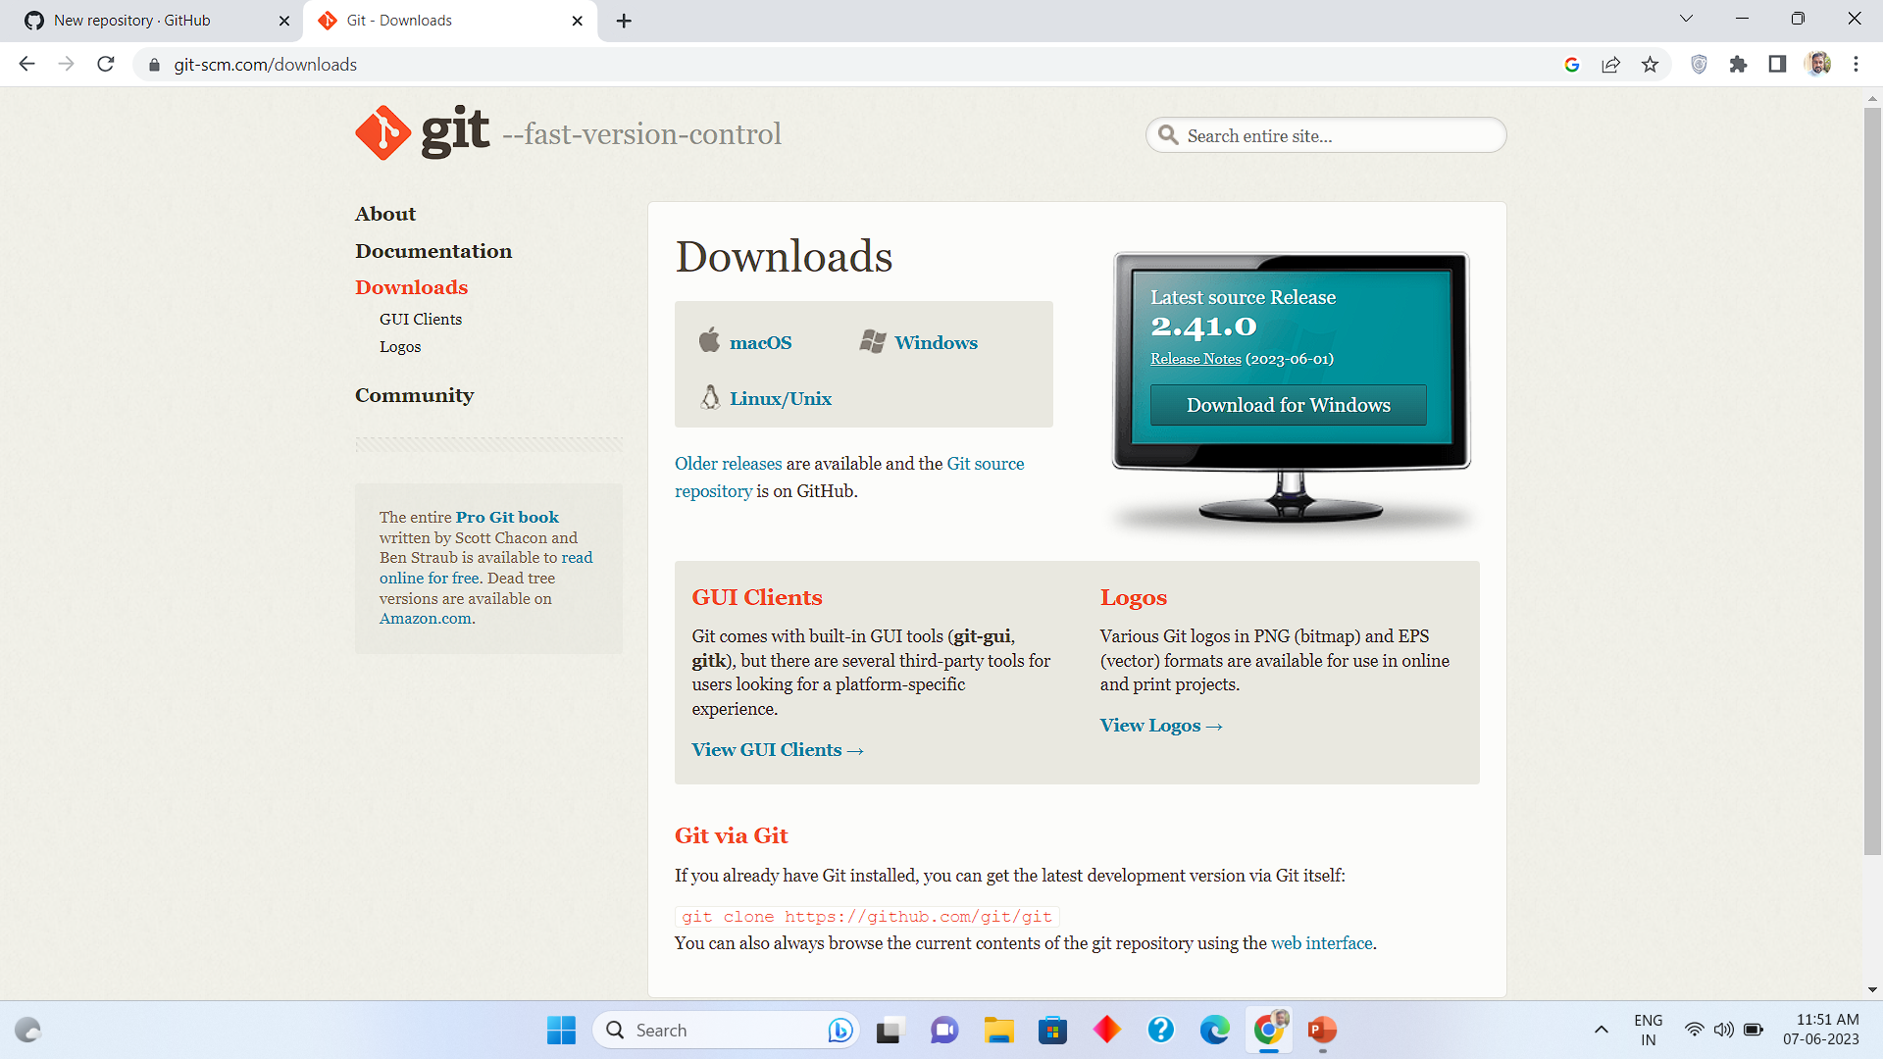
GIT CLI download line
https://git-scm.com/downloads

Slide 3
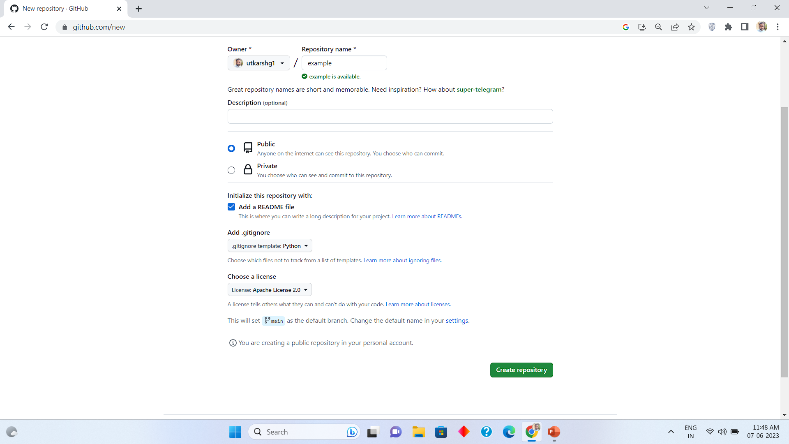
Create github repository with following options

Slide 4
4 important git commands
git status
git add .
git commit -m “First Commit”
git push

Slide 5
Thank you
Utkarsh gaikwad

